Slide 1
CoiffHub
The ultimate dimensions of talent and style
Book now, explore your options
Who we are
Blog
How it works
Become a Coiff
Sign In
Download App
Deals

Slide 2




CoiffHub
Who we are
Blog
How it works
Become a Coiff
Sign In
Download App
Deals
You are simply talented !
Our Mission
To inspire innovation, upgrade quality, and customize possibilities of hairstyle and allowing folks to recognize the local inspiring talents of the hairstyle industry.
Why trust us with your appearance
Coiffhub is an artificialy intelligent webapplication to help Men and Weman choose a hairstyle or a haircut, book a Coiffueur, and save time and money. It matches the coiffeure and the client based on the client's cut choisen. Coiffhub does more than this, it recommands haircuts and products based on the data collected about the client. The service can be provided at the nearest salon-partner, the Coiffueur's salone, or at the client's house. Clients can electronically pay. They are given rewards points for the money you spend, and they have access to many exclusive products they need.

Slide 4
INDEX
HEADER
Who we are
Blog
How it works
Become a Coiff partner
Sing in
Download App
Deals
What’s new
BODY
What’s new
Personal and Family Deals
Business Deals
What people say about us
Available in these cities
Real time geomap
Check out your location
FOOTER
Business Deals
Press
Policies
Careers
Giftcard
Help

Slide 5
Who we are

Slide 6
Blog

Slide 7
How it works

Slide 8
Become a HUB

Slide 9
Get your HUB

Slide 10
Download App

Slide 11
SOMEHub for business

Slide 12
Deals and packages

Slide 13
What people say about us

Slide 14
Help

Slide 15
New and Events

Slide 16
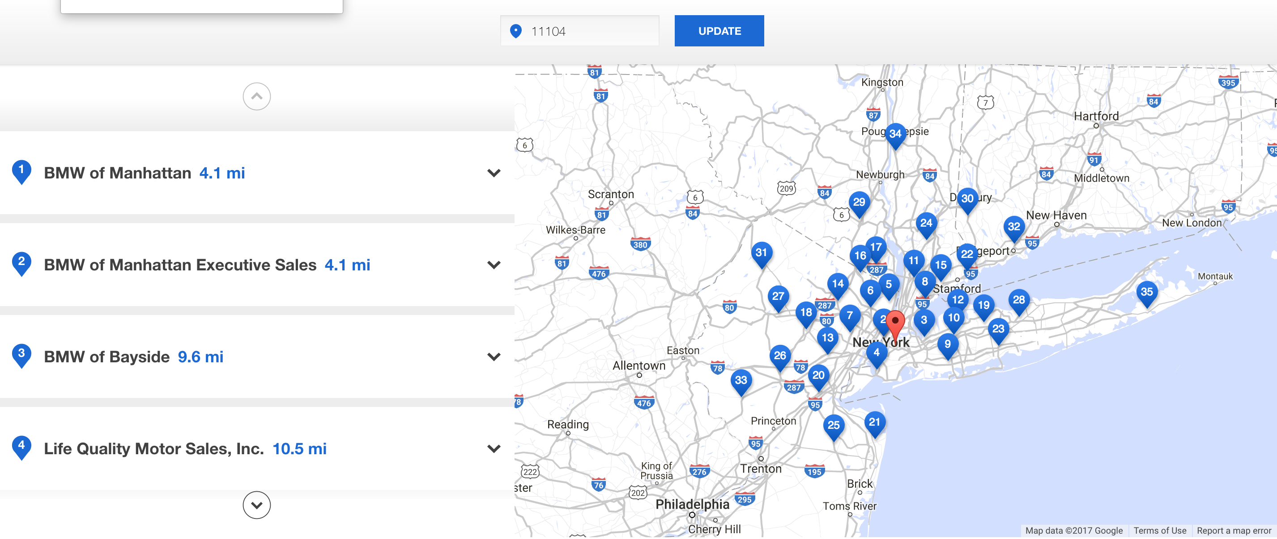
Check your location
Partners near you
Hairstylists near you

Slide 17
